Slide 1


Expresso: Comprehensively Reasoning About External Routes Using Symbolic Simulation
SIGCOMM’24, August 8, 2024
Dan Wang, Peng Zhang
Aaron Gember-Jacobson
Notes:
Hello everyone, I’m Dan from Xi’an Jiaotong University. Today I’m honored to introduce our work, named Expresso, which can comprehensively reason about external routes using symbolic simulation. This is a joint work with Colgate University.

Slide 2
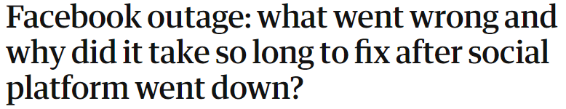
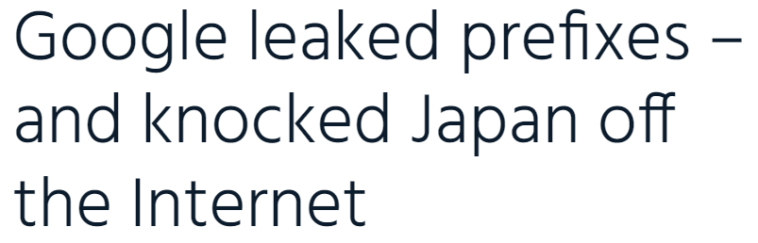
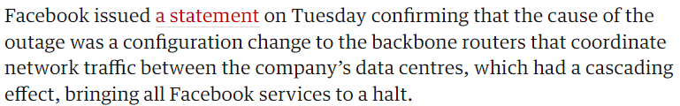
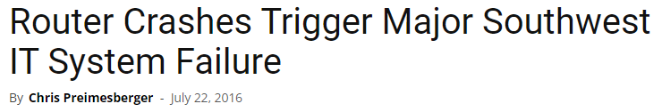

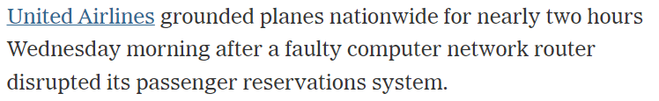
Network Outages are Common and Costly
a statement
BGP Route Leak at Angola Cables Slows Connectivity for Many Australians
By Aftab Siddiqui – 25 May 2023
Notes:
Network outages are common and costly, hitting the news again and again.

Slide 3


Control Plane Verifiers (CPVs)
configs
CPV
results
topology
Notes:
Therefore, control plane verifiers are developed to proactively find misconfigurations before implementation. CPVs take network configurations and topology as input, and check whether properties like reachability hold.

Slide 4
Req #1: Reasoning About Failures
a statement
BGP Route Leak at Angola Cables Slows Connectivity for Many Australians
By Aftab Siddiqui – 25 May 2023
Notes:
Many outages are caused by link or node failures.

Slide 5
CPV #1: Reasoning About Failures
Minesweeper^{[3]}
Hoyan^{[6]}
SRE^{[7]}
……
configs
CPV
results
topology
+ failure
Notes:
As a result, many verifiers that can reason about failures are developed. For example, Minesweeper, Hoyan, and SRE.

Slide 6
Req #2: Reasoning About Config Updates
a statement
BGP Route Leak at Angola Cables Slows Connectivity for Many Australians
By Aftab Siddiqui – 25 May 2023
Notes:
Many other outages are caused by configuration updates.

Slide 7

CPV #2: Reasoning About Config Updates
+ updates
DNA^{[8]}
JinJing^{[13]}
……
configs
CPV
results
topology
Notes:
Accordingly, verifiers that can reason about configuration updates have emerged, like DNA and JinJing.

Slide 8
Req #3: Reasoning About External Routes
a statement
BGP Route Leak at Angola Cables Slows Connectivity for Many Australians
By Aftab Siddiqui – 25 May 2023
Notes:
However, another less considered cause of outages is external routes.

Slide 9


Reasoning About External Route is Important
…
ISP₁
AS 300
ISP₂
N1
A
B
N2
…
route leak
…
ISP₁
AS 300
ISP₂
N1
A
B
N2
…
traffic hijack
Notes:
Reasoning about external routes is important, since external route induced incidents can cause multiple issues. For one example, if a network leaks routes from one ISP to another, it is at the risk of being a free transit between those two ISP, which will cause financial loss. For another, if a network’s traffic is hijacked by another network, its private data is at risk.

Slide 10

Space of External Route is Colossal
…
ISP₁ AS 100
AS 300
ISP₂ AS 200
N1
A
B
N2
…
0.0.0.0/0
0.0.0.0/1
128.0.0.0/1
……
255.255.255.255/32
#Prefix = $2^{33}−1$
Notes:
However, reasoning about external routes is challenging, since the space of external route is colossal. For IPv4, we have $2^{33}−1$ prefixes.

Slide 11
Space of External Route is Colossal
182.185.152.0/22
241.25.0.0/16
153.42.96.0/19
…
82.183.39.0/24
54.170.144.0/20
ISP₁ AS 100
AS 300
ISP₂ AS 200
N1
A
B
N2
…
0.0.0.0/0
0.0.0.0/1
128.0.0.0/1
……
255.255.255.255/32
#Prefix = $2^{33}−1$
Notes:
Theoretically, each external neighbor can announce an arbitrary set of prefixes.

Slide 12
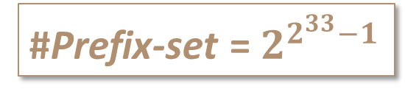
Space of External Route is Colossal
182.185.152.0/22
241.25.0.0/16
153.42.96.0/19
…
82.183.39.0/24
54.170.144.0/20
ISP₁ AS 100
AS 300
ISP₂ AS 200
N1
A
B
N2
…
0.0.0.0/0
0.0.0.0/1
128.0.0.0/1
……
255.255.255.255/32
#Prefix = $2^{33}−1$
#Prefix-set = $2^{2^{33}−1}$
Notes:
And there are $2^{2^{33}−1}$ prefix sets.

Slide 13
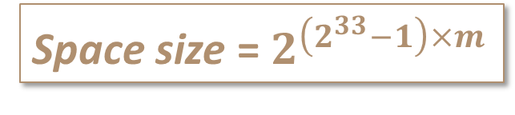
Space of External Route is Colossal
182.185.152.0/22
241.25.0.0/16
153.42.96.0/19
…
82.183.39.0/24
54.170.144.0/20
ISP₁ AS 100
AS 300
ISP₂ AS 200
N1
A
B
N2
…
0.0.0.0/0
0.0.0.0/1
128.0.0.0/1
……
255.255.255.255/32
#Prefix = $2^{33}−1$
Space size = $2^{\left(2^{33}−1\right)×m}$
#Prefix-set = $2^{2^{33}−1}$
#Neighbor
Notes:
For the whole space, suppose we have $m$ external neighbors, then we have to multiply the number of prefix sets for $m$ times.

Slide 14

Space of External Route is Colossal
182.185.152.0/22
241.25.0.0/16
153.42.96.0/19
…
82.183.39.0/24
54.170.144.0/20
ISP₁ AS 100
AS 300
ISP₂ AS 200
N1
A
B
N2
…
How to handle such a colossal space?
Space size = $2^{\left(2^{33}−1\right)×m}$
#Neighbor
Notes:
So how to handle such a colossal space?

Slide 15
Method #1: Enumerate Concrete External Routes
182.185.152.0/22
241.25.0.0/16
153.42.96.0/19
…
82.183.39.0/24
54.170.144.0/20
ISP₁ AS 100
AS 300
ISP₂ AS 200
N1
A
B
N2
…
SRE^{[7]}, Hoyan^{[6]}, Tiramisu^{[9]}, Plankton^{[10]}, Shapeshifter^{[4]}, ERA^{[11]}, Batfish^{[1]}
Enumeration is infeasible
Notes:
As verifiers like Batfish consider concrete external routes, to use them to comprehensively reason about the whole space of external routes, we have to enumerate concrete external routes. However, enumeration is infeasible because of the huge space size.

Slide 16

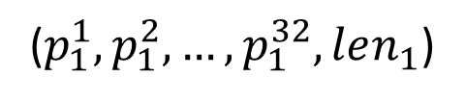
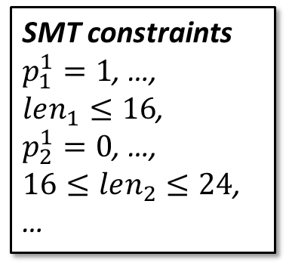
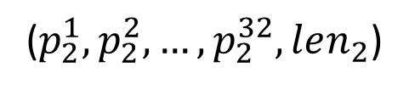
Method #2: Symbolize External Routes with SMT
…
ISP₁ AS 100
($p_{1}^{1},p_{1}^{2},…,p_{1}^{32},len_{1}$)
AS 300
($p_{2}^{1},p_{2}^{2},…,p_{2}^{32},len_{2}$)
ISP₂ AS 200
N1
A
B
N2
…
SMT constraints
$p_{1}^{1}=1$, …,
$len_{1}≤16$,
$p_{2}^{1}=0$, …,
$16≤len_{2}≤24$,
…
NV^{[5]}, Minesweeper^{[3]}, Bagpipe^{[12]}
Z3
SMT solving is Unscalable
Notes:
Another method is to symbolize external routes using SMT, which can free us from enumeration. But in practice, we found it unscalable as the generated SMT constraints cannot be solved by SMT solvers in a reasonable amount of time.

Slide 17


Our Approach: Expresso
Express
Espresso
Notes:
As existing verifiers are ill-suited to reason about external routes, we design and implement Expresso.

Slide 18
Example Network
ISP₁ AS 100
AS 300
ISP₂ AS 200
N1
A
B
N2
Notes:
We use this network to demonstrate the design of Expresso. It contains two internal routers $A$ and $B$, and two external routers $N1$ and $N2$.

Slide 19
Example Network
3-bit IP addresses: 110, 010, …
3-bit prefixes: 000/0, 000/1, …, 111/3
ISP₁ AS 100
AS 300
ISP₂ AS 200
N1
A
B
N2
Notes:
We use three-bit IP addresses and prefixes for simplicity.

Slide 20
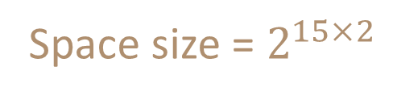
Example Network
3-bit IP addresses: 110, 010, …
3-bit prefixes: 000/0, 000/1, …, 111/3
Space size = $2^{15×2}$
15
ISP₁ AS 100
AS 300
ISP₂ AS 200
N1
A
B
N2
Notes:
Accordingly, we have 15 prefixes in total, and the space size is $2^{30}$.

Slide 21
Example Network
route-policy im1 permit node 100
if-match prefix 100/2 110/2
set-local-preference 200
route-policy im2 permit node 100
if-match prefix 100/2 110/2
set-local-preference 100
ISP₁ AS 100
AS 300
ISP₂ AS 200
N1
A
B
N2
Notes:
In the network, $A$ and $B$ peer with two ISPs. Both of them permit two prefixes, 100/2 and 110/2 from the ISPs.

Slide 22
Example Network
route-policy im1 permit node 100
if-match prefix 100/2 110/2
set-local-preference 200
route-policy im2 permit node 100
if-match prefix 100/2 110/2
set-local-preference 100
ISP₁ AS 100
AS 300
ISP₂ AS 200
N1
A
B
N2
Preferred exit to Internet
Notes:
And $A$ sets the local preference of routes from N1 to 200, in order to prefer N1 to N2 as the exit to reach the Internet.

Slide 23
Observation1: Equivalence
Prefix Equivalence
000/0
000/1
100/1
000/2
010/2
100/2
110/2
000/3
001/3
010/3
011/3
100/3
101/3
110/3
111/3
route-policy im1 permit node 100
if-match prefix 100/2 110/2
set-local-preference 200
route-policy im2 permit node 100
if-match prefix 100/2 110/2
set-local-preference 100
ISP₁ AS 100
AS 300
ISP₂ AS 200
N1
A
B
N2
Notes:
When designing Expresso, we have several observations.
Firstly, we observe two types of equivalence in the external route environment space.
One is prefix equivalence.
That is, prefixes that match the same or equivalent route policies throughout the network will be treated the same during route computation.
As in the example network, 100/2 and 110/2 are equivalent, while all other prefixes are equivalent.

Slide 24
Observation1: Equivalence
Advertiser Equivalence
{}
{N1}
{N2}
{N1,N2}
For 100/2 and 110/2
route-policy im1 permit node 100
if-match prefix 100/2 110/2
set-local-preference 200
route-policy im2 permit node 100
if-match prefix 100/2 110/2
set-local-preference 100
ISP₁ AS 100
AS 300
ISP₂ AS 200
N1
A
B
N2
Notes:
The other is advertiser equivalence.
That is, for a prefix, whether or not a neighbor advertises the prefix does not impact the best routes.
As in the example network, $A$ sets the local preference of routes from N1 to 200.
Therefore, for prefix 100/2 and 110/2, whenever advertised by N1, will be selected as best routes, regardless of whether advertised by N2 or not.

Slide 25

How to Explore Equivalences?
......
100/2
110/2
……
……
100/2
110/2
……
......
100/2
110/2
……
……
100/2
110/2
……
N1
N2
N1
N2
EC#1: N1 announces 100/2, 110/2
EC#2: Only N2 announces 100/2, 110/2
......
100/2
110/2
……
……
100/2
110/2
……
SRE^{[7]} SIGCOMM’22
Symbolic simulation
N1
N2
EC#3: No announcement for 100/2, 110/2
Notes:
While the space size is as large as $2^{30}$, there’s only 3 equivalence classes. Therefore, we choose to follow the way of our prior work SRE, which executes symbolic simulation to efficiently explore equivalences.

Slide 26
Workflow of Symbolic Simulation^{[7]}
Symbolic Route Computation (SRC)
Symbolic Packet Forwarding
(SPF)
Property Analysis
Configurations
Topology
Notes:
This is the workflow of symbolic simulation, which takes configurations and topology as input, then executes symbolic route computation, symbolic packet forwarding and property analysis.

Slide 27


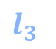
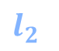
SRE Makes Link Symbolic
Symbolic Route Computation (SRC)
Symbolic Packet Forwarding
(SPF)
Property Analysis
Configurations
$l_{1}$
$l_{3}$
$l_{2}$
$l_{4}$
Topology
+
Symbolic
link states
Notes:
In symbolic route computation, SRE symbolizes the up or down state of links.

Slide 28
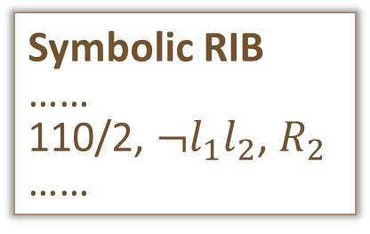
SRE Computes Failure Equivalence Classes
Symbolic Route Computation (SRC)
Symbolic Packet Forwarding
(SPF)
Property Analysis
Configurations
$l_{1}$
$l_{3}$
Symbolic RIB
……
110/2, $¬l_{1}l_{2}$, $R_{2}$
……
$l_{2}$
$l_{4}$
Topology
+
Symbolic
link states
Symbolic RIBs
Notes:
It then executes a fix-point algorithm to compute symbolic RIBs.

Slide 29


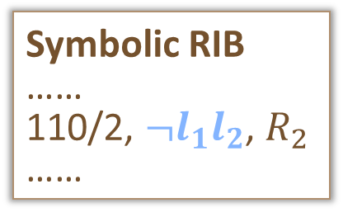
SRE Computes Failure Equivalence Classes
Symbolic Route Computation (SRC)
Symbolic Packet Forwarding
(SPF)
Property Analysis
Configurations
$l_{1}$
$l_{3}$
Symbolic RIB
……
110/2, $¬l_{1}l_{2}$, $R_{2}$
……
$l_{2}$
$l_{4}$
Topology
+
Symbolic
link states
Symbolic RIBs
Failure Equivalence Class
Notes:
Which contain failure equivalence classes. For Example, $¬l_{1}l_{2}$ represents a failure equivalence class containing four failure scenarios.
For expresso, we aim to symbolize external route environments, and compute symbolic RIBs containing prefix and advertiser equivalence classes.

Slide 30
Modeling Symbolic Routes As Symbolic Links
ISP₁ AS 100
AS 300
ISP₂ AS 200
N1
PR₁
PR₂
N2
000/0
…
100/1
…
110/2
…
111/3
Notes:
A straight-forward extension to SRE goes like this.
We add “dummy” nodes for prefixes.

Slide 31
Modeling Symbolic Routes As Symbolic Links
ISP₁ AS 100
AS 300
ISP₂ AS 200
N1
PR₁
PR₂
N2
000/0
…
100/1
…
110/2
…
111/3
Notes:
Then we add a link between every “external neighbor node” and “every prefix node”. For each link, its up or down state indicates whether the external neighbor announces the prefix or not

Slide 32
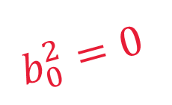
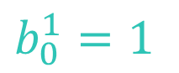
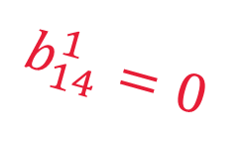
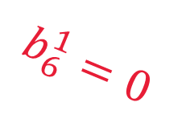

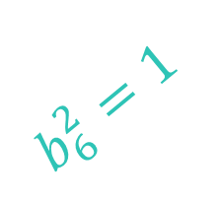
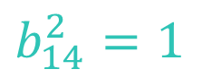
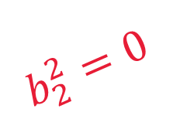
SRE Encoding: Select by Link Variables
$N1$ announces 000/0, $N2$ announces 110/2 and 111/3
ISP₁ AS 100
AS 300
ISP₂ AS 200
N1
PR₁
PR₂
N2
$$b_{14}^{1}=0$$
$$b_{0}^{2}=0$$
$$b_{6}^{1}=0$$
$$b_{2}^{2}=0$$
$$b_{2}^{1}=0$$
$$b_{6}^{2}=1$$
$$b_{0}^{1}=1$$
$$b_{14}^{2}=1$$
000/0
…
100/1
…
110/2
…
111/3
Notes:
Following SRE, we assign a boolean variable for each link. Then link states are decided by assigning 0 or 1 to link variables.

Slide 33
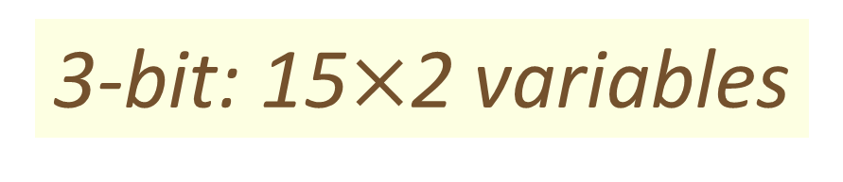
SRE Encoding: Select by Link Variables
ISP₁ AS 100
AS 300
ISP₂ AS 200
N1
PR₁
PR₂
N2
3-bit: 15$×$2 variables
#Prefix
#Neighbor
000/0
…
100/1
…
110/2
…
111/3
Notes:
This way, we need 30 variables in total, where 15 is the number of prefixes, and 2 is the number of external neighbors.

Slide 34
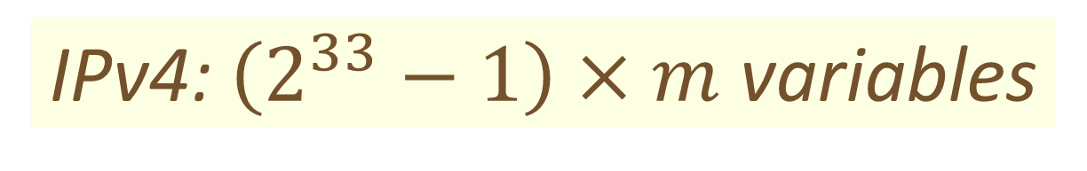
SRE Encoding: Select by Link Variables
ISP₁ AS 100
AS 300
ISP₂ AS 200
N1
PR₁
PR₂
N2
IPv4: $\left(2^{33}−1\right)×m$ variables
#Prefix
#Neighbor
000/0
…
100/1
…
110/2
…
111/3
Notes:
However, for IPv4, we still need $\left(2^{33}−1\right)×m$ variables.

Slide 35
Observation2: Independency in Route Computation
ISP₁ AS100
AS300
ISP₂ AS200
100/2
Prefixes mostly
Independent¹
N1
A
B
N2
110/2
1 Network features like route aggregation can cause dependencies, please refer to our paper for more details.
Notes:
Fortunately, we observe that prefixes are mostly independent in route computation. That is, the computations of routes for different prefixes do not interfere with each other.

Slide 36
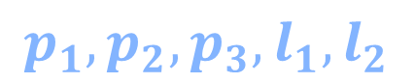
Expresso Encoding: First Select Prefixes
ISP₁ AS 100
AS 300
ISP₂ AS 200
N1
PR₁
PR₂
N2
IP address vars
$$p_{1},p_{2},p_{3},l_{1},l_{2}$$
Prefix length vars
000/0
…
100/1
…
110/2
…
111/3
Notes:
Consequently, we can first use five variables to select prefixes. Three for IP address variables, and two for prefix length variables.

Slide 37
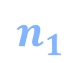
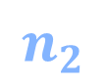
Expresso Encoding: Then Select Advertisers
ISP₁ AS 100
AS 300
ISP₂ AS 200
$$n_{1}$$
N1
PR₁
PR₂
N2
$$n_{2}$$
000/0
…
100/1
…
110/2
…
111/3
Notes:
Then we use 2 variables to select external neighbors.

Slide 38
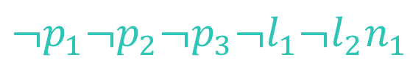
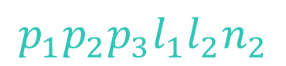
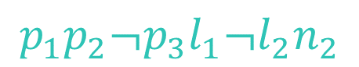
Example
$N1$ announces 000/0, $N2$ announces 110/2 and 111/3
ISP₁ AS 100
AS 300
ISP₂ AS 200
N1
PR₁
PR₂
N2
reused
$$p_{1}p_{2}¬p_{3}l_{1}¬l_{2}n_{2}$$
$$¬p_{1}¬p_{2}¬p_{3}¬l_{1}¬l_{2}n_{1}$$
$$p_{1}p_{2}p_{3}l_{1}l_{2}n_{2}$$
000/0
…
100/1
…
110/2
…
111/3
Notes:
This way, the selected links are represented by IP addresses variables, prefix length variables, and external neighbor variables collectively. As shown for $N2$, the reusage of its neighbor variable $n_{2}$ is enabled by prefix dependency.

Slide 39
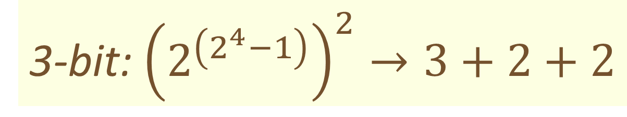
Expresso Encoding
ISP₁ AS 100
AS 300
ISP₂ AS 200
N1
PR₁
PR₂
N2
3-bit: ${\left(2^{\left(2^{4}−1\right)}\right)}^{2}→3+2+2$
IP address
#Neighbor
000/0
…
100/1
…
Prefix length
110/2
…
111/3
Notes:
Using this encoding, we only need 7 variables in total.

Slide 40
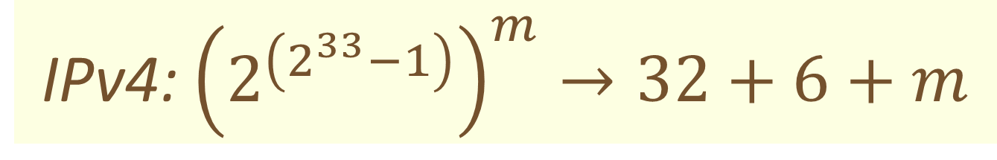
Expresso Encoding
ISP₁ AS 100
AS 300
ISP₂ AS 200
N1
PR₁
PR₂
N2
IPv4: ${\left(2^{\left(2^{33}−1\right)}\right)}^{m}→32+6+m$
IP address
#Neighbor
000/0
…
100/1
…
110/2
Prefix length
…
111/3
Notes:
For IPv4, we can use only $38+m$ variables to symbolize the external route space of size ${\left(2^{\left(2^{33}−1\right)}\right)}^{m}$.

Slide 41
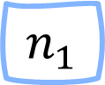
Expresso SRC: Initialize Symbolic Route
Arbitrary prefixes announced by N1
$$n_{1}$$
❶
N1
A
B
N2
Notes:
Based on the encoding, we illustrate symbolic route computation with the propagation of the external route from $N1$. Here, $n_{1}$ is the symbolic prefix, indicating arbitrary prefixes announced by router $N1$. We omit other route attributes for simplicity.

Slide 42
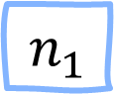
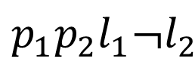
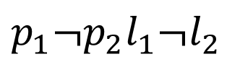
Expresso SRC: Route Propagation
$$p_{1}¬p_{2}l_{1}¬l_{2}$$
$$p_{1}p_{2}l_{1}¬l_{2}$$
route-policy im1 permit node 100
if-match prefix 100/2 110/2
set-local-preference 200
$$n_{1}$$
❶
N1
A
B
N2
Notes:
Then it propagates to router $A$, whose import policy only permits prefix 100/2 and 110/2.

Slide 43

Expresso SRC: Apply Routing Policy
$$p_{1}¬p_{2}l_{1}¬l_{2}$$
$$p_{1}p_{2}l_{1}¬l_{2}$$
route-policy im1 permit node 100
if-match prefix 100/2 110/2
set-local-preference 200
$$n_{1}$$
❶
N1
A
B
N2
$$p_{1}l_{1}¬l_{2}n_{1}$$
❷
$$n_{1}∧\left(p_{1}¬p_{2}l_{1}¬l_{2}∨p_{1}p_{2}l_{1}¬l_{2}\right)$$
Notes:
After going through router $A$’s import policy, route 1 converts into route 2. The symbolic prefix changes to $p_{1}l_{1}¬l_{2}n_{1}$, resulting from intersecting the original symbolic prefix $n_{1}$ with the disjunction of 100/2 and 110/2’s boolean representations.

Slide 44

Expresso SRC: Route Propagation
$$n_{1}$$
❶
N1
A
B
N2
❹
$$p_{1}l_{1}¬l_{2}n_{1}$$
❷
$$p_{1}l_{1}¬l_{2}n_{1}$$
Notes:
The propagation continues. Finally, the route passes the export policy of $B$ and is leaked to $N2$.

Slide 45
Symbolic Packet Forwarding
Symbolic Route Computation (SRC)
Symbolic Packet Forwarding
(SPF)
Property Analysis
Configurations
RIB
FIB
Topology
Compute Symbolic FIBs
Forward Symbolic Packets
Notes:
After symbolic route computation, is symbolic packet forwarding, which contains first converting symbolic RIBs to symbolic FIBs, then forwards symbolic packets to compute packet equivalence classes.

Slide 46
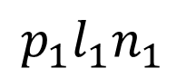
Prefix Dependency in Packet Forwarding Due to Longest Prefix Match
100/1
1 variable per neighbor is not enough any more.
100/3
Dependent
$$p_{1}l_{1}n_{1}$$
101/3
110/3
111/3
15 variables per neighbor now?
Notes:
However, when computing symbolic FIBs, there’s another challenge.
Since in data plane, there are dependencies among prefixes.
For example, symbolic prefix $p_{1}l_{1}n_{1}$ contains five prefixes, one /1 prefix and 4 /3 prefixes.
And the /1 prefix depends on all /3 prefixes, due to the longest prefix match principle.
It indicates that one variable per neighbor is insufficient now. So does it mean that we need 15 variables per neighbor now?

Slide 47
Observation3: Dependency is Limited to Different Prefix Length
100/1
100/1
100/3
Dependent
100/3
$$p_{1}l_{1}n_{1}$$
101/3
101/3
Mutually Independent
110/3
110/3
111/3
111/3
Notes:
Fortunately, the dependency is limited to prefixes having the same first bits but different lengths. Prefixes having the same prefix length are still independent.

Slide 48
Expresso Data Plane Encoding
AS 300
N1
PR₁
PR₂
N2
0
1
2
3
0
1
2
3
000/0
…
100/1
…
110/2
…
111/3
Notes:
As a result, in data plane, we add a dummy node for each neighbor and prefix length.

Slide 49

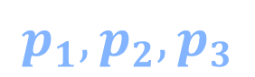
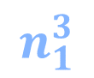
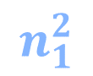
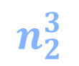
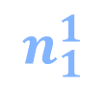
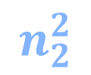

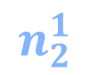
Expresso Data Plane Encoding
AS 300
N1
PR₁
PR₂
N2
0
1
2
3
0
1
2
3
$$n_{1}^{0}$$
$$n_{1}^{1}$$
$$n_{1}^{2}$$
$$n_{1}^{3}$$
$$n_{2}^{0}$$
$$n_{2}^{1}$$
$$n_{2}^{2}$$
$$n_{2}^{3}$$
000/0
…
100/1
…
110/2
…
111/3
$$p_{1},p_{2},p_{3}$$
Notes:
Then we use IP address variables and length-specific neighbor variables for encoding.

Slide 50
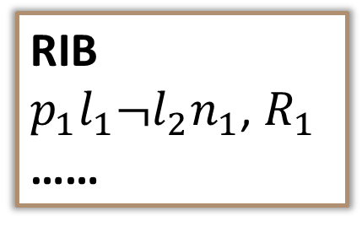
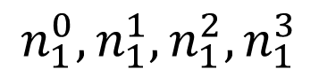
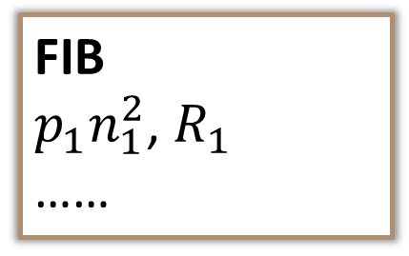
Expresso Compute Symbolic FIBs
length vars
neighbor vars
RIB
$p_{1}l_{1}¬l_{2}n_{1}$, $R_{1}$
……
FIB
$p_{1}n_{1}^{2}$, $R_{1}$
……
$$n_{1}^{0},n_{1}^{1},n_{1}^{2},n_{1}^{3}$$
length-specific neighbor vars
Notes:
Accordingly, when computing FIBs, we have to convert control plane length and neighbor variables into data plane length-specific neighbor variables.
In this example, $n_{1}$ is converted into four new variables.

Slide 51
Expresso Compute Symbolic FIBs
length vars
neighbor vars
RIB
$p_{1}l_{1}¬l_{2}n_{1}$, $R_{1}$
……
FIB
$p_{1}n_{1}^{2}$, $R_{1}$
……
$$n_{1}^{0},n_{1}^{1},n_{1}^{2},n_{1}^{3}$$
length-specific neighbor vars
Notes:
However, as $l_{1}¬l_{2}$ indicates prefix length 2, only $n_{1}^{2}$ is needed.

Slide 52
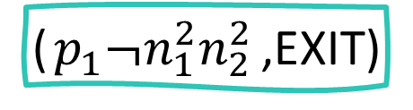
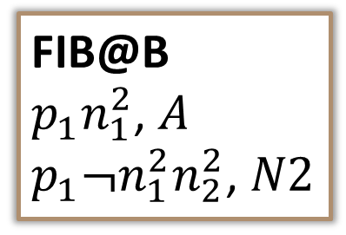
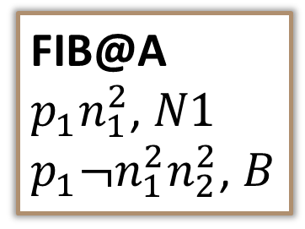
Expresso compute PECs
FIB@A
$p_{1}n_{1}^{2}$, $N1$
$p_{1}¬n_{1}^{2}n_{2}^{2}$, $B$
FIB@B
$p_{1}n_{1}^{2}$, $A$
$p_{1}¬n_{1}^{2}n_{2}^{2}$, $N2$
A
B
N2
True
($p_{1}¬n_{1}^{2}n_{2}^{2}$,EXIT)
Notes:
This figure shows the symbolic packet forwarding beginning at router $A$. The symbolic packet is initialized with a symbolic packet header True, which can match any forwarding rules. It then continues matching symbolic FIBs and being forwarded, until either arrive at the destination, or exit the network, or encounter a forwarding loop or blackhole.

Slide 53
Expresso compute PECs
FIB@A
$p_{1}n_{1}^{2}$, $N1$
$p_{1}¬n_{1}^{2}n_{2}^{2}$, $B$
FIB@B
$p_{1}n_{1}^{2}$, $A$
$p_{1}¬n_{1}^{2}n_{2}^{2}$, $N2$
A
B
N2
Exit the network
True
($p_{1}¬n_{1}^{2}n_{2}^{2}$,EXIT)
Prefixes 1**/*
Prefix length is 2,
announced by N2 but not N1
Notes:
The forwarding results in a symbolic packet exiting the network. For the symbolic packet header, $p_{1}$ means prefixes whose first bit is 1. This boolean formula containing length-specific neighbor variables means the prefix length is 2, and the prefix is announced by $N2$ but not $N1$. And EXIT indicates that the packet finally exits the network.

Slide 54
Property Analysis
x
Route Leak
Route Hijack
❶
❷
No BTE
x
Traffic Hijack
Egress Preference
Block To External
Notes:
After symbolic packet forwarding, is property analysis. Expresso checks five properties, that is route leak, route hijack, traffic hijack, egress preference, and block to external. Please refer to our paper for details about how we check these properties.

Slide 55
Evaluation Results On the WAN of a Cloud Service Provider (CSP)
Notes:
Finally, we show the evaluation results of Expresso on a cloud service provider’s WAN.

Slide 56
A Cloud Service Provider’s WAN
Region1
Region3
O(10) neighbors
O(40) neighbors
PR₁
PR₄
RR
Region2
Region4
O(20) neighbors
O(20) neighbors
PR₂
PR₃
PR: Peering Router, RR: Route Reflector
Notes:
The CSP’s WAN contains 4 regions. Each region contains several peering routers, which peer with external neighbors. All regions are connected by a route reflector.

Slide 57
Found Violations
AS200
AS100
AS200
AS100
AS200
AS100
ISP_{a}
PR₁
ISP_{a}
PR₁
ISP_{a}
PR₁
RR
RR
traffic hijack
RR
route leak
route hijack
AS300
ISP_{b}
PR₂
PR₂
PR₂
DR₂
6 confirmed
17 confirmed
19 confirmed
Notes:
We found route leaks, route hijacks, and traffic hijacks on it.

Slide 58
Case Study (A Route Hijack)
(242.138.112.88/31, 100, BGP)
AS200
AS100
ISP_{a}
PR₁
RR
(242.138.112.88/31, CONNECTED)
PR₂
PR: Peering Router, RR: Route Reflector
Notes:
And I’ll show the details of a potential route hijack found by Expresso. It begins with ${ISP}_{a}$ announcing a /31 prefix to $PR_{1}$.

Slide 59
Case Study (A Route Hijack)
(242.138.112.88/31, 100, BGP)
route-policy import node 100
if-match prefix-list list1
set-local-preference 200
ip prefix list1 node 100 deny 114.247.96.0 20 le 32
ip prefix list1 node 200 deny 123.29.0.0 20 le 32
ip prefix list1 node 300 deny 137.155.0.0 18 le 32
ip prefix list1 node 400 deny 92.230.128.0 18 le 32
ip prefix list1 node xxx deny 242.138.120.0 20 le 32
ip prefix list1 node 500 permit 0.0.0.0 0 le 32
AS200
AS100
ISP_{a}
PR₁
(200, BGP)
RR
(242.138.112.88/31, CONNECTED)
missing
PR₂
PR: Peering Router, RR: Route Reflector
Notes:
Then, the route is permitted by $PR_{1}$’s import policy, which is misconfigured as it misses one deny entry in the prefix list to deny this internal prefix. The route’s local preference is set to 200.

Slide 60
Case Study (A Route Hijack)
(242.138.112.88/31, 100, BGP)
AS200
AS100
ISP_{a}
PR₁
(200, BGP)
RR
(100, BGP)
(242.138.112.88/31, CONNECTED)
PR₂
PR: Peering Router, RR: Route Reflector
Notes:
At the same time, the connected route at $PR_{2}$ is redistributed into BGP and propagated to $RR$.

Slide 61
Case Study (A Route Hijack)
(242.138.112.88/31, 100, BGP)
AS200
AS100
ISP_{a}
PR₁
(200, BGP)
RR
(100, BGP)
(242.138.112.88/31, CONNECTED)
(200, BGP)
PR₂
PR: Peering Router, RR: Route Reflector
Notes:
Then, at $RR$, it chooses the external route instead of the internal one because of having a higher local preference.

Slide 62

Case Study (A Route Hijack)
(242.138.112.88/31, 100, BGP)
AS200
AS100
ISP_{a}
PR₁
(200, BGP)
RIB@RR
……
242.138.112.88/31, 200, $PR_{1}$, $ISP_{a}$
……
RR
(100, BGP)
(242.138.112.88/31, CONNECTED)
(200, BGP)
PR₂
route hijack
PR: Peering Router, RR: Route Reflector
Notes:
Expresso finds the route hijack by finding this route in $RR$’s symbolic RIB.
And it has been confirmed and corrected by the operators.

Slide 63


Performance
1h
Minesweeper $≈$1 day
Expresso <1h
full
Notes:
This figure compares the running time of Minesweeper and Expresso to check route leak free on the CSP’s WAN.
Where Minesweeper uses nearly 1 day, while Expresso completes in 1 hour.

Slide 64
Performance
Expresso is 1-4 orders of magnitude faster
full
Notes:
Since Minesweeper timeout on the full topology, we use the four regions as micro benchmarks to compare Minesweeper and Expresso.
The results show that Expresso is generally 1-4 orders of magnitude faster than Minesweeper.

Slide 65
Summary
External route caused incidents are common and costly.
External route environment space is colossal and existing verifiers cannot explore it efficiently.
Expresso uses equivalences and independencies to efficiently explore the space of external routes through symbolic simulation.
Expresso finds real violations on a CSP’s WAN.
Notes:
In summary, we first motivate the necessity of reasoning about external route environments. Then we introduce key points of Expresso’s design. Finally, we show that Expresso finds real bugs on a cloud service provider’s WAN.

Slide 66



Expresso: Comprehensively Reasoning About External Routes Using Symbolic Simulation
Dan Wang
Peng Zhang
Aaron Gember-Jacobson
Xi’an Jiaotong University
Colgate University
Notes:
Ok, that’s all for my presentation. I’m happy to take your questions now.

Slide 67
Reference
[1] Fogel, Ari, et al. "A general approach to network configuration analysis." 12th USENIX Symposium on Networked Systems Design and Implementation (NSDI 15). 2015.
[2] Weitz, Konstantin, et al. "Scalable verification of border gateway protocol configurations with an SMT solver." Proceedings of the 2016 acm sigplan international conference on object-oriented programming, systems, languages, and applications. 2016.
[3] Beckett, Ryan, et al. "A general approach to network configuration verification." Proceedings of the Conference of the ACM Special Interest Group on Data Communication. 2017.
[4] Beckett, Ryan, et al. "Abstract interpretation of distributed network control planes." Proceedings of the ACM on Programming Languages 4.POPL (2019): 1-27.
[5] Giannarakis, Nick, et al. "NV: An intermediate language for verification of network control planes." Proceedings of the 41st ACM SIGPLAN Conference on Programming Language Design and Implementation. 2020.
[6] Ye, Fangdan, et al. "Accuracy, scalability, coverage: A practical configuration verifier on a global wan." Proceedings of the Annual conference of the ACM Special Interest Group on Data Communication on the applications, technologies, architectures, and protocols for computer communication. 2020.

Slide 68
Reference
[7] Zhang, Peng, Dan Wang, and Aaron Gember-Jacobson. "Symbolic router execution." Proceedings of the ACM SIGCOMM 2022 Conference. 2022.
[8] Zhang, Peng, et al. "Differential network analysis." 19th USENIX Symposium on Networked Systems Design and Implementation (NSDI 22). 2022.
[9] Abhashkumar, Anubhavnidhi, Aaron Gember-Jacobson, and Aditya Akella. "Tiramisu: Fast multilayer network verification." 17th USENIX Symposium on Networked Systems Design and Implementation (NSDI 20). 2020.
[10] Prabhu, Santhosh, et al. "Plankton: Scalable network configuration verification through model checking." 17th USENIX Symposium on Networked Systems Design and Implementation (NSDI 20). 2020.
[11] Fayaz, Seyed K., et al. "Efficient network reachability analysis using a succinct control plane representation." 12th USENIX Symposium on Operating Systems Design and Implementation (OSDI 16). 2016.
[12] Weitz, Konstantin, et al. "Scalable verification of border gateway protocol configurations with an SMT solver." Proceedings of the 2016 acm sigplan international conference on object-oriented programming, systems, languages, and applications. 2016.
[13] Tian, Bingchuan, et al. "Safely and automatically updating in-network acl configurations with intent language." Proceedings of the ACM Special Interest Group on Data Communication. 2019. 214-226.

